Slide 1

Decision Tree and Random Forest classifier
Presented by H.T.M.D Samaranayake

Slide 2
Titanic Dataset Analysis & Prediction
Objective: Predict survival of Titanic passengers using machine learning.
Dataset: Information on Titanic passengers, including demographics, class, and survival status.
Methods Used:
Data Cleaning: Handling missing values, removing irrelevant columns, encoding categories.
Algorithms Applied: Decision Tree & Random Forest (both are classification algorithms).

Slide 3
Data Preprocessing & Model Selection
Data Preparation Steps:
Removing Unnecessary Columns: Passenger ID, Name, Ticket, Cabin
Handling Missing Values: Filled Age with median; Embarked with mode.
Encoding Categorical Variables: Converted Sex and Embarked to numbers.

Slide 4
Algorithms:
Decision Tree: Simple, interpretable, useful for initial predictions.
Random Forest: Ensemble of trees, better generalization and accuracy.

Slide 5
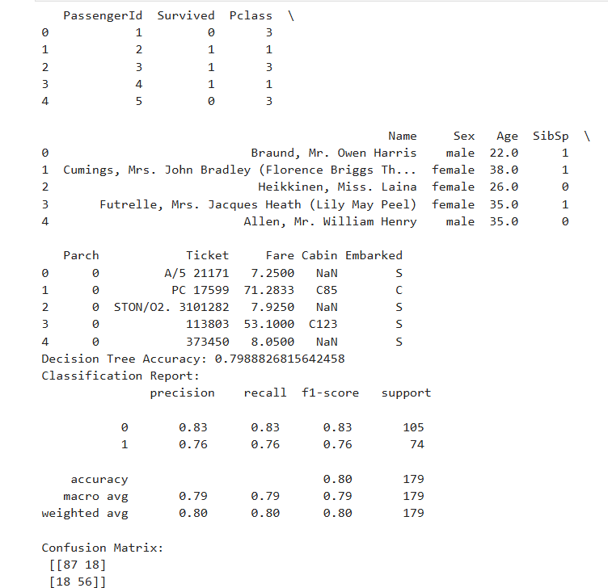
Results & Insights

